Slide 1
Network Fundamentals
Prepared By: Er. Amit kr Tewari
Associate Professor
CS Dept.
ACEIT, Jaipur

Slide 2
Network Fundamentals
A network is a communication system with two or more stations that can communicate with one another.
When it is desired to have each computer communicate with two or more additional computers, the interconnections can become complex.

Slide 3

Network Fundamentals The number of links L required between N PCs (nodes) is determined by using the formula.

Slide 4
Network Fundamentals (Contd…)
The number of links or cables increases in proportion to the number of nodes involved.
Figure indicates, if four computers are to be interconnected, there must be three links to each PC.

Slide 5
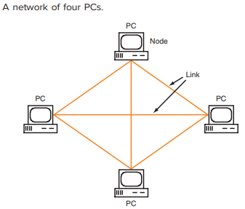
Network Examples

Slide 6
Types of Networks
Each computer or user in a network is referred to as a node.
The interconnection between the nodes is referred to as the communication link.
In most computer networks, each node is a personal computer, but in some cases a peripheral device such as a laser printer or an embedded controller built into another piece of equipment can be a node.

Slide 7
Types of Networks
There are four basic types of electronic networks in common use:
Wide-Area Networks (WANs)
Metropolitan-Area Networks (MANs)
Local-Area Networks (LANs)
Personal-Area Networks (PANs)

Slide 8
Wide-Area Networks (WANs)
A WAN covers a significant geographic area.
Local telephone systems are WANs, as are the many long-distance telephone systems linked together across the country and to WANs in other countries.
Any node can contact any other node in the system.
The nationwide and worldwide fiber-optic networks set up since the to carry Internet traffic are also WANs.

Slide 9
Metropolitan-Area Networks (MANs)
MANs are smaller networks that generally cover a city, town, or village.
Cable TV systems are MANs.
The cable TV channel selector boxes are all nodes in the system.

Slide 10
Local-Area Networks (LANs)
A LAN consists primarily of personal computers interconnected within an office or building.
Most LAN systems connect 10 to several thousand users.
Small LANs can be used by a company to interconnect several offices in the same building; in such cases, wiring can be run between different floors of the building to make the connection.
Larger LANs can interconnect several buildings within a complex, e.g., large companies with multiple buildings, military installations, and college campuses.

Slide 11
Personal-Area Networks (PANs)
A PAN is a short-range wireless network that is set up automatically between two or more devices such as laptop computers, peripheral devices, or cell phones.
The distance between the devices is very short, no more than about 10 m and usually much less.
PANs are referred to as ad hoc networks that are set up for a specific single purpose, such as the transfer of data between the devices as required by some application.

Slide 12
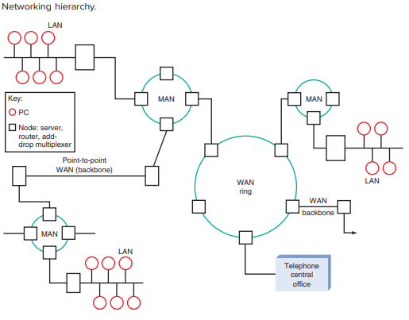

Slide 13
Network Topologies
The topology of a network describes the basic communication paths between, and methods used to connect, the nodes on a network.
The three most common topologies used are star, ring, and bus. These topologies apply to the LAN, MAN, and WAN.

Slide 14
Star Topology
A basic star configuration consists of a central controller node and multiple individual stations connected to it.
The resulting system resembles a multipointed star. The central or controlling PC, often referred to as the server, is typically larger and faster than the other PCs and contains a large hard drive where shared data and programs are stored.
Any communication between two PCs passes through the server.
The server and its software manage the linkup of individual computers and the transfer of data between them.

Slide 15
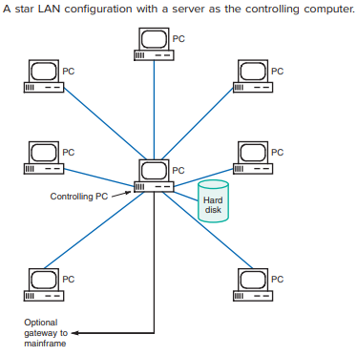

Slide 16
Advantages
A star-type LAN is extremely simple and straightforward.
New nodes can be quickly and easily added to the system. Furthermore, the failure of one node does not disable the entire system.
Of course, if the server node goes down, the network is disabled, although the individual PCs will continue to operate independently.

Slide 17
Disadvantages
Star networks generally require more cable than other network topologies.
The fact that all communication must pass through the node does place some speed restrictions on the transfer of data.

Slide 18
Bus Topology
A bus is simply a common cable to which all the nodes are attached.
The bus is bidirectional in that signals can be transmitted in either direction between any two of the nodes; however, only one of the nodes can transmit at a given time.
The primary advantage of the bus is that it is faster than any of the other topologies. The wiring is simple, and the bus can be easily expanded.
Bus topology is not great for large networks.
Identification of problem becomes difficult if whole network goes down.

Slide 19
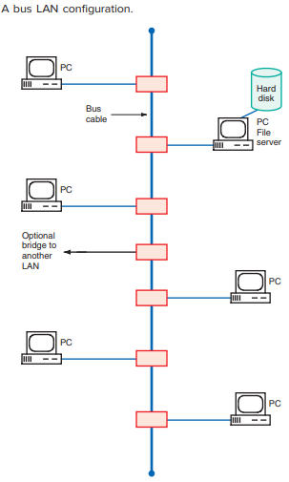
Bus Topology

Slide 20
Mesh Topology
A mesh network is one in which each node is connected to all other nodes.
Of course this leads to major costs and complications as the number of nodes increases.
The primary value of the mesh network is that there are multiple paths for data to take from one node to another.
This provides for redundancy that can provide a continuous connection when one or more of the links are broken.
The lack of one link does not keep the data from reaching its destination by another path.
This redundancy provides increased network reliability.
Most partial mesh networks are implemented with wireless links.

Slide 21
Other Topologies
The daisy chain topology is simply a ring that has been broken.
Another variation is called the tree topology. This topology is simply a bus design in which each node has multiple interconnections to other nodes through a star interconnection.
In others, the network consists of branches from one node to two or more other nodes.

